Slide 1
Introduction to Julia
A programming language for scientific computing

Slide 2
Content
What is Julia?
Why Julia?
Benchmark Examples
Interesting language features
Live demo
Questions

Slide 3
What is Julia?
In a Nutshell:
Julia is a fast programming language, designed from the ground up for high performance.
Julia is dynamically typed, it feels like a scripting language and has great support for interactive use.
Julia is reproducible, having a built-in package manager and being available across a wide range of platforms.
Julia is Open Source – under the MIT license.

Slide 4
Why Julia? – The Two Language Problem
Develop code in an easy to use, dynamic language like Python or MATLAB
If code is performance sensitive, then rewrite your code in a faster language like C/C++ or Fortran.
Attempts have been made to make this easier, such as porting code like Linear Algebra to C and then calling from the slower language. (numpy for python)
Limited to what has already been ported over, what if that code doesn’t exist?

Slide 5
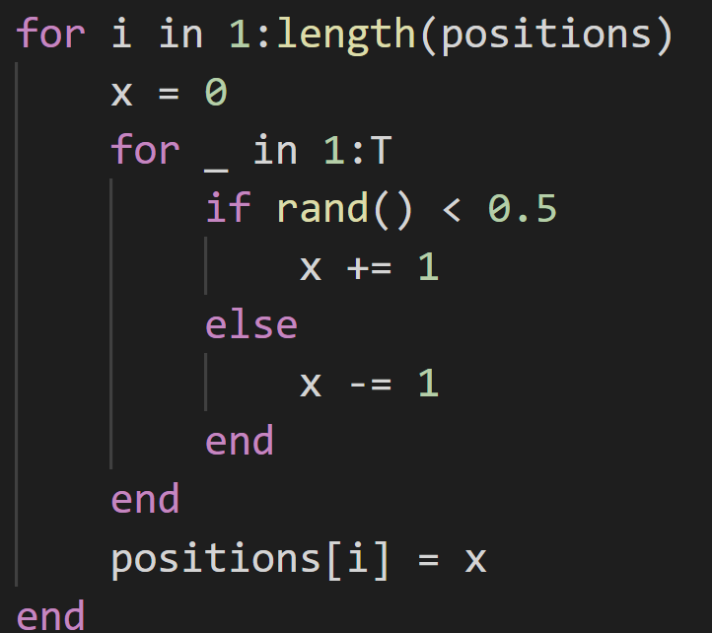
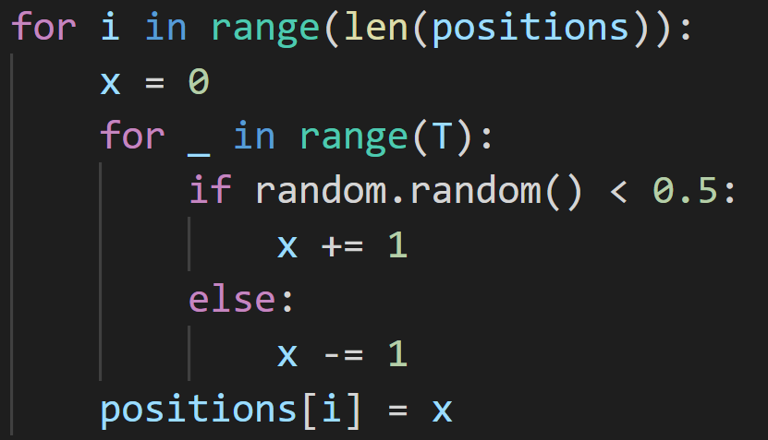


Python vs Julia – Random Walk benchmark
$$N=2^{10}$$
$$T=100$$
Julia:
Python:
$$N=2^{10}$$
$$T=100$$
8509.3 μs
313.5 μs
Julia is around 30 times faster here

Slide 6
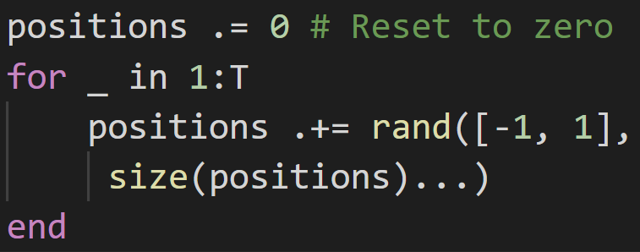
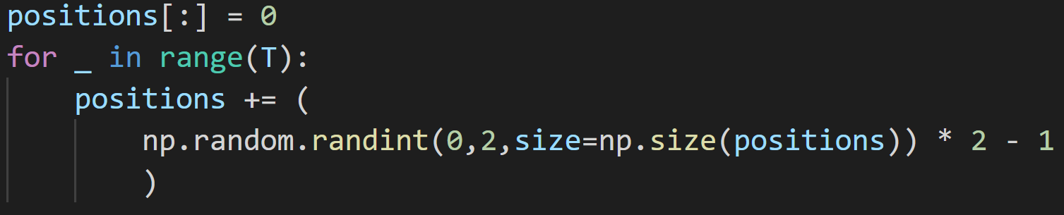
Python vs Julia – Random Walk w/ Arrays
$$N=2^{10}$$
$$T=100$$
378.7 μs
Julia:
1415.8 μs
Python:
Julia is only around 4x faster here, but numpy implementation could be better

Slide 7
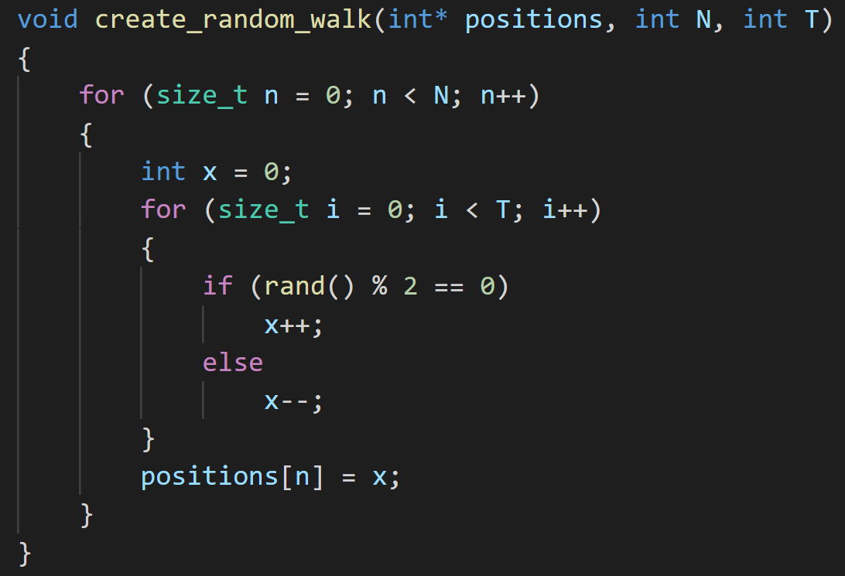
C++ vs Julia – Random Walk benchmark
$$N=2^{10}$$
$$T=100$$
Julia:
C/C++:
$$N=2^{10}$$
$$T=100$$
509 μs
313.5 μs
Julia is around 1.6 times faster here

Slide 8
Why is Julia fast?
Just-in-Time compiled, which specialises on the types of the variables.
Compiler tries to perform many optimisations, such as Single Instruction Multiple Data (SIMD) commands which most modern CPUs support.
Only fast if type stable!

Slide 9
So what?

Slide 10
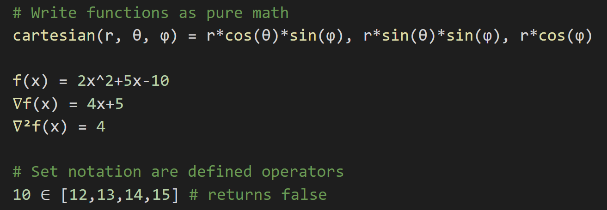
Interesting language features
Full support for Unicode:

Slide 11
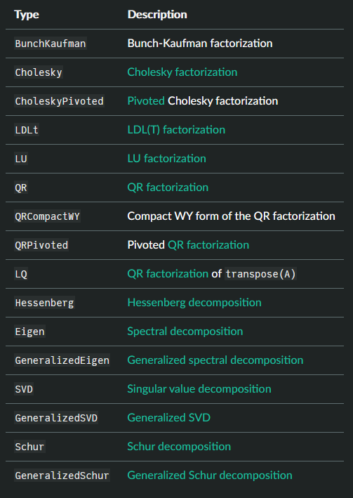
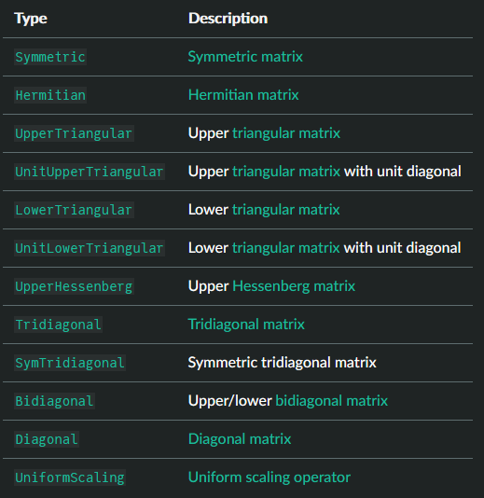
Interesting language features
Native support for linear algebra: (with choice of OpenBLAS or MKL)

Slide 12
Interesting language features
Metaprogramming macros – code that writes code
@simd macro on for loops tells the compiler to write out a for loop in a hardware vectorised format
Threads.@threads will parallelise your code across multiple threads trivially
@btime (from BenchmarkTools.jl) allows you to easily benchmark code, without any boilerplate
Many code introspection tools like @code_warntype, @code_llvm and @code_native to help write performant code.

Slide 13
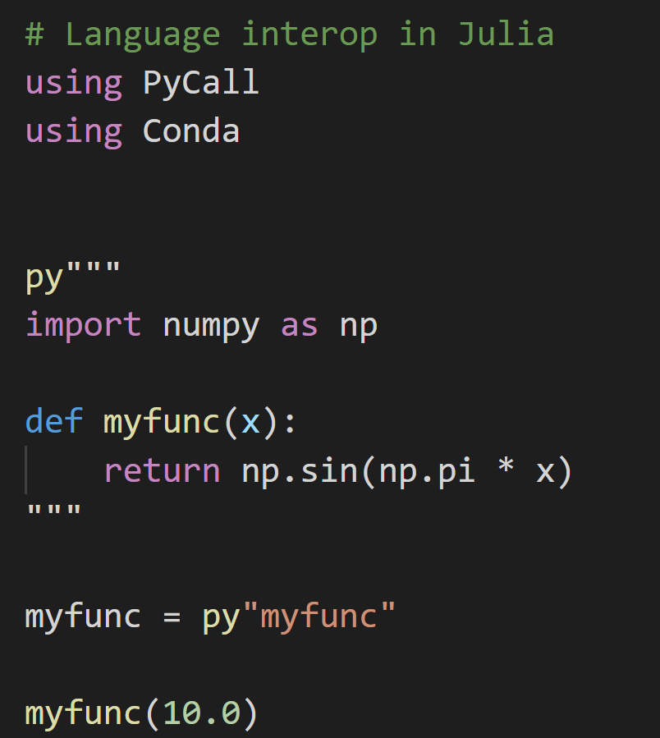
Interop – Calling other languages from Julia
Pure python code

Slide 14
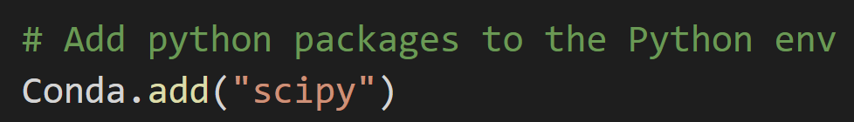
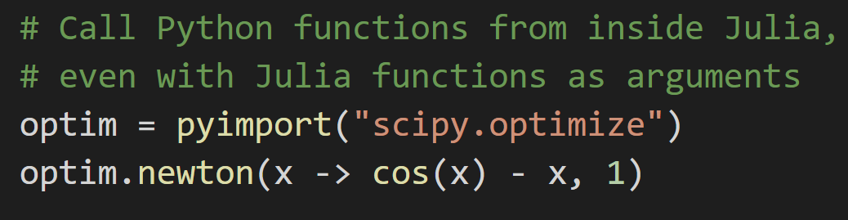
Interop – Calling other languages from Julia

Slide 15
Different Type of Parallelism
Multithreading – single program shares memory has different threads (workers) that can execute tasks. Requires locking to make sure same thread doesn’t read and write to same memory at the same time.
Multiprocessing – what MATLAB and Python use. Spin up a copy of the program in a new process and communicate over sockets – high latency and poor performance if lots of communication needed.
Hardware Parallelism – SIMD instructions built into CPU.
GPU parallelism – a different discrete chip in a computer designed for massively parallel workloads.

Slide 16
GPU – Graphics Processing Unit
Designed for accelerating 3D graphics to allow real-time rendering.
Early workflows included mapping millions of vertices from 3D world coordinates to a camera perspective. This is just linear algebra!
Modern GPUs have 10s of thousands of cores compared to CPUs with usually 10s of cores. These cores are slower and less general.
GPUs workloads are usually memory intensive, and so they have their own memory (VRAM), separate from the main DRAM memory.

Slide 17
Interesting language features – LIVE DEMO
Great support for parallelising your code across multiple cores or an entire cluster
Great support for using GPUs!

Slide 18
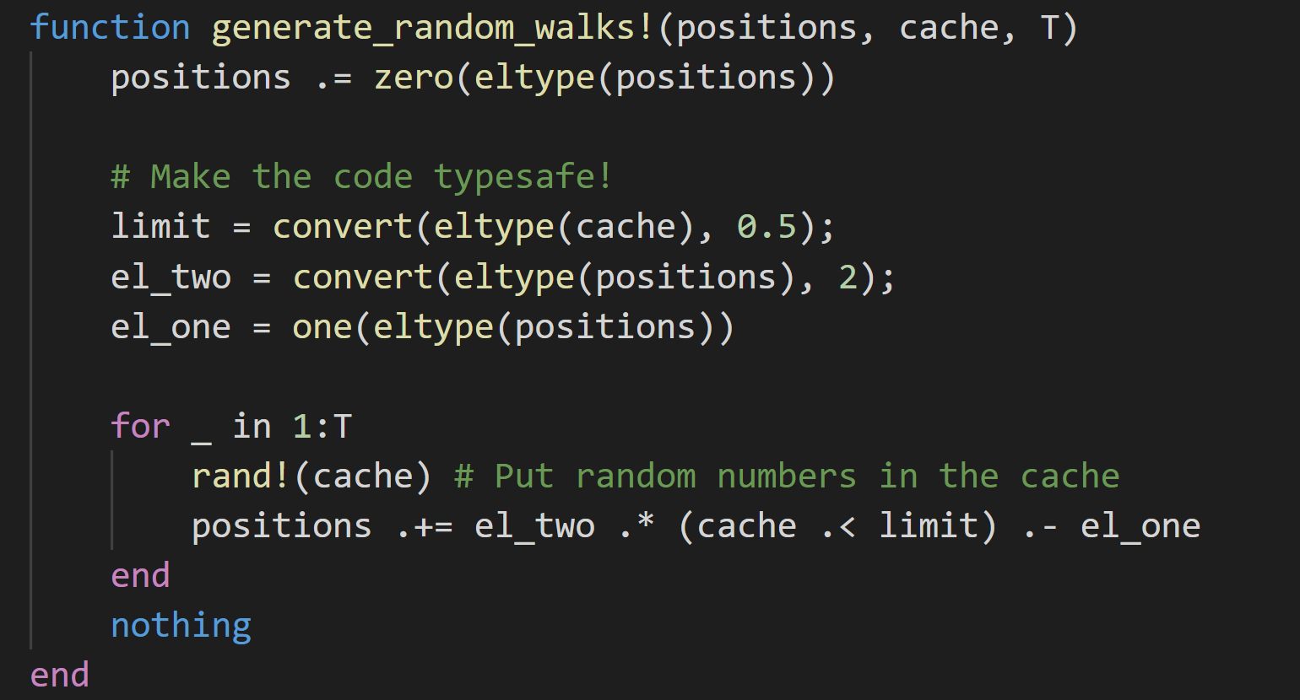
Array version of Monte Carlo simulation

Slide 19
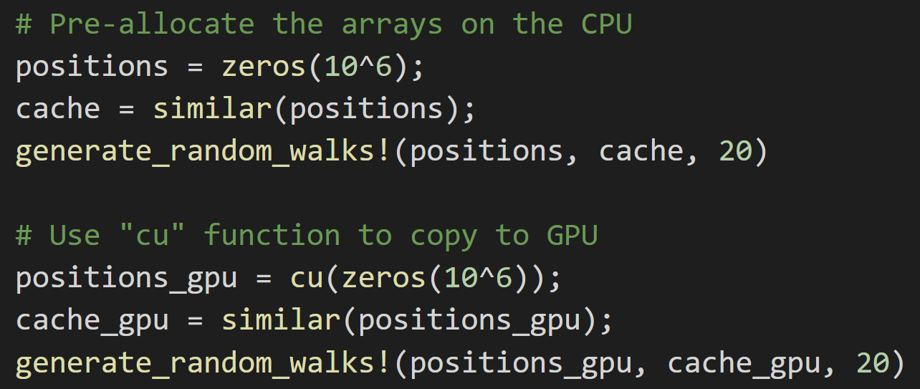
Using CPU vs GPU

Slide 20
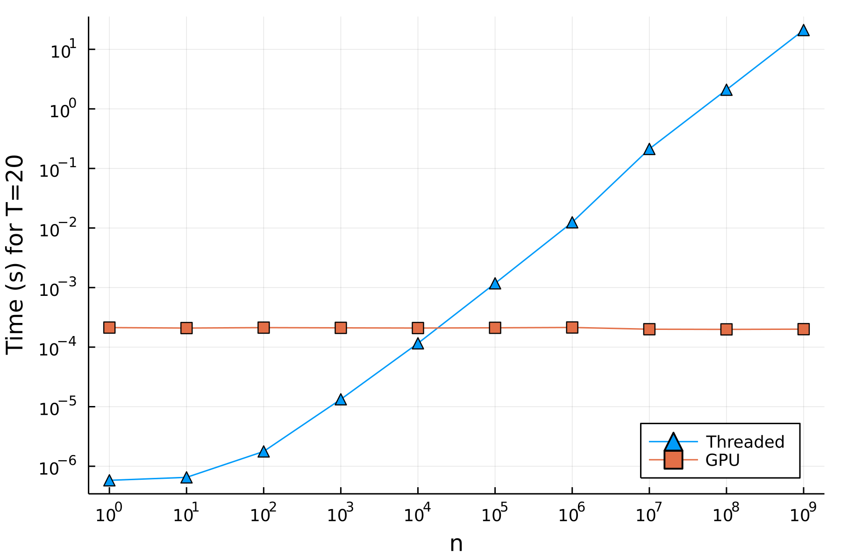
Using GPUs for parallelism

Slide 21
Downsides of Julia
Index of arrays start from 1, not 0.
Need to learn type system and multiple dispatch
Have to wait for compilation – high latency, especially suffers in plotting with the TFFP (time for first plot) problem
No classes! Only functions and data structures
Can take a bit of practice to get the best performance
Smaller community – it might be difficult to find help

Slide 22
Best resources to start
The Julia documentation! https://docs.julialang.org/en/v1/manual/getting-started/
Computational Thinking | MIT Course (w/ 3Blue1Brown): https://www.youtube.com/playlist?list=PLP8iPy9hna6Q2Kr16aWPOKE0dz9OnsnIJ
Parallel Computing and Scientific Machine Learning | MIT: https://github.com/mitmath/18337
Julia high performance (book): https://nusearch.nottingham.ac.uk/permalink/f/t1e4u0/TN_cdi_askewsholts_vlebooks_9781788292306

Slide 23
Questions?

Slide 24
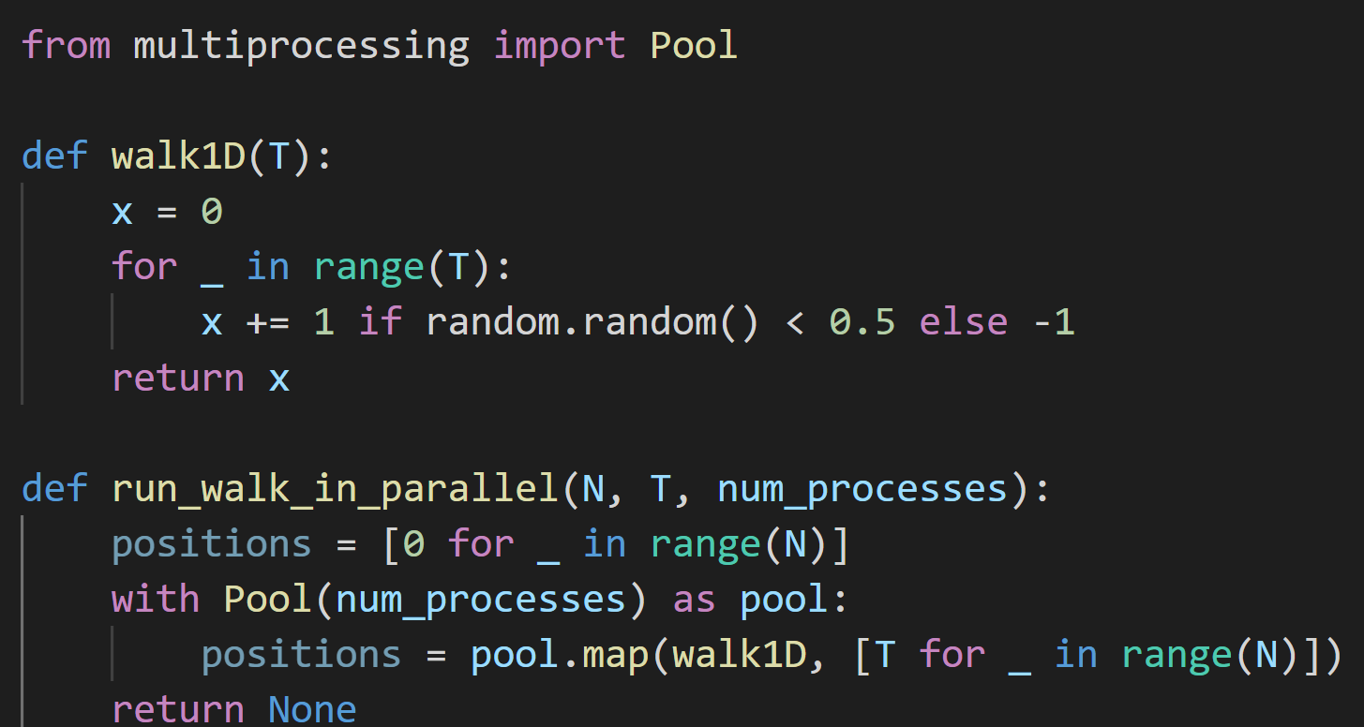

Python vs Julia – Random Walk in Parallel
Python:
$$N=2^{20}$$
$$T=100$$
1030ms

Slide 25
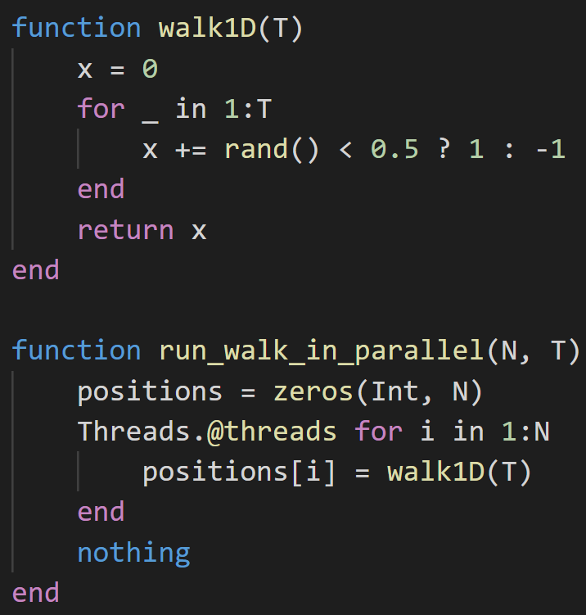

Python vs Julia – Random Walk in Parallel
Julia:
~40 times faster than in Python.
$$N=2^{20}$$
$$T=100$$
25.16ms

Slide 26
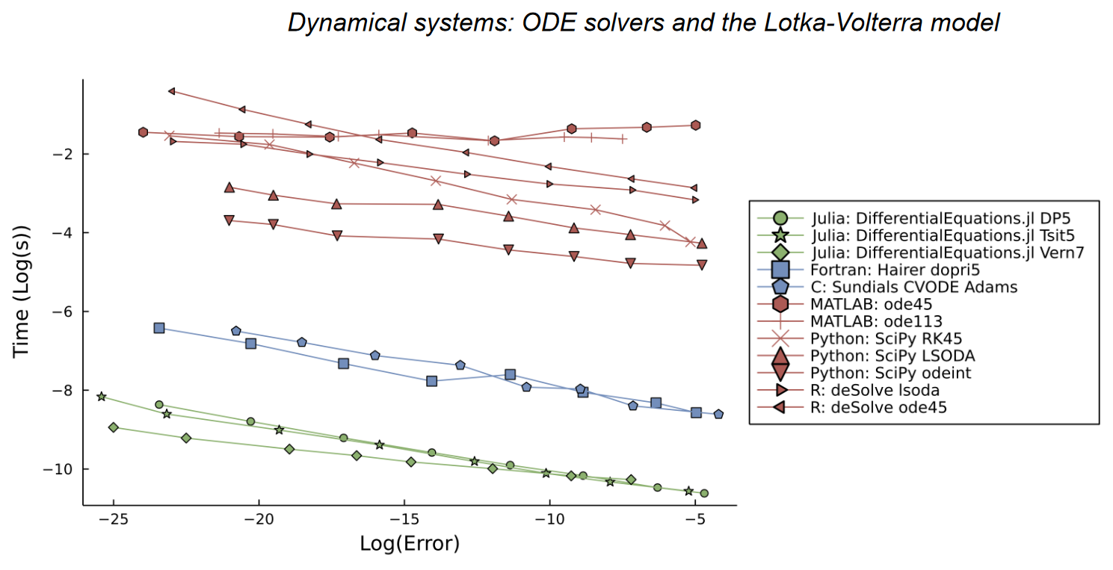
Performance in DifferentialEquations.jl
Julia for Biologists: https://arxiv.org/abs/2109.09973

